Slide 1
3
Working with Financial Statements

Slide 2

Chapter 3 – Index of Sample Problems
Slide # 02 - 06 Sources and uses of cash
Slide # 07 - 08 Cash flow categories
Slide # 09 - 12 Common-size statements
Slide # 13 - 18 Liquidity ratios
Slide # 19 - 26 Long-term solvency ratios
Slide # 27 - 33 Asset utilization ratios
Slide # 34 - 46 Profitability ratios, including DuPont
Slide # 47 - 48 Market value ratios

Slide 3
2: Sources and uses of cash
Complete the table by indicating which accounts are a source of cash and which are a use of cash. The next slide provides the answers.
 | 2005 | 2004 | Source/Use
Cash | $ 18,900 | $ 17,300
Accounts receivable | 12,350 | 13,480
Inventory | 76,200 | 75,400 | U
Net fixed assets | 425,000 | 452,000
Accounts payable | 26,800 | 28,500
Long-term debt | 195,600 | 230,900
Common stock | 220,000 | 210,000
Retained earnings | 90,050 | 88,780

Slide 4
3: Sources and uses of cash
The asset accounts are shown in light yellow. The liability and equity accounts are in light blue.
 | 2005 | 2004 | Source/Use
Cash | $ 18,900 | $ 17,300 | U
Accounts receivable | 12,350 | 13,480 | S
Inventory | 76,200 | 75,400 | U
Net fixed assets | 425,000 | 452,000 | S
Accounts payable | 26,800 | 28,500 | U
Long-term debt | 195,600 | 230,900 | U
Common stock | 220,000 | 210,000 | S
Retained earnings | 90,050 | 88,780 | S

Slide 5
4: Sources and uses of cash
Balance Sheet
Liabilities
and
Asset Cash Equity Cash
Increase Use Increase Source
Decrease Source Decrease Use

Slide 6
5: Sources and uses of cash
What is the amount of each source and use of cash?
 | 2005 | 2004 | Source/Use | Amount of source or use
Accounts receivable | $ 12,350 | $ 13,480 | S | $ 1,130
Net fixed assets | 425,000 | 452,000 | S
Common stock | 220,000 | 210,000 | S
Retained earnings | 90,050 | 88,780 | S
 |  |  | Total: | $39,400
Cash | $ 18,900 | $ 17,300 | U
Inventory | 76,200 | 75,400 | U
Accounts payable | 26,800 | 28,500 | U
Long-term debt | 195,600 | 230,900 | U
 |  |  | Total: | $39,400
The asset accounts are shown in yellow. The liability and equity accounts are in blue.

Slide 7
6: Sources and uses of cash
The sources of cash must equal the uses of cash.
 | 2005 | 2004 | Source/Use | Amount of source/use
Accounts receivable | $ 12,350 | $ 13,480 | S | 1,130
Net fixed assets | 425,000 | 452,000 | S | 27,000
Common stock | 220,000 | 210,000 | S | 10,000
Retained earnings | 90,050 | 88,780 | S | 1,270
 |  |  | Total: | $39,400
Cash | $ 18,900 | $ 17,300 | U | $ 1,600
Inventory | 76,200 | 75,400 | U | 800
Accounts payable | 26,800 | 28,500 | U | 1,700
Long-term debt | 195,600 | 230,900 | U | 35,300
 |  |  | Total: | $39,400

Slide 8
7: Cash flow categories
For each of the following accounts, identify whether they are an operating activity (O), an investment activity (I), or a financing activity (F).
Account | O, I, or F | Account | O, I, or F
Accounts payable | O | Cash
Accounts receivable |  | Dividends paid
Long-term debt |  | Retained earnings
Net income |  | Interest paid
Inventory |  | Paid in surplus
Common stock |  | Sales

Slide 9
8: Cash flow categories
Financing = Long-term debt, equity, interest paid and dividends
Investing = Long-term assets
Operating = Current assets, current liabilities and income statement accounts, excluding
interest paid
Account | O, I, or F | Account | O, I, or F
Accounts payable | O | Cash | O
Accounts receivable | O | Dividends paid | F
Long-term debt | F | Retained earnings | F
Net income | O | Interest paid | F
Inventory | O | Paid in surplus | F
Common stock | F | Fixed assets | I

Slide 10
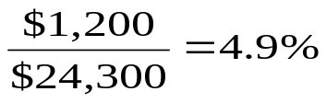
9: Common-size statements
  Complete the table by inserting the common-size ratios.
  Round all numbers to the nearest 1/10 of a percent.
Assets |  |  | Liabilities and equity
Cash | $ 1,200 | 4.9% | Accounts payable | $1,700
Accounts receivable | 2,600 |  | Long-term debt | 9,800
Inventory | 4,900 |  | Common stock | 10,000
Net fixed assets | 15,600 |  | Retained earnings | 2,800
Total assets | $24,300 | 100.0% | Total liabilities and equity | $24,300

Slide 11
10: Common-size statements
  Total assets is set equal to 100%. All other accounts are expressed as a percentage of total assets.
Assets |  |  | Liabilities and equity
Cash | $ 1,200 | 4.9% | Accounts payable | $1,700 | 7.0%
Accounts receivable | 2,600 | 10.7% | Long-term debt | 9,800 | 40.3%
Inventory | 4,900 | 20.2% | Common stock | 10,000 | 41.2%
Net fixed assets | 15,600 | 64.2% | Retained earnings | 2,800 | 11.5%
Total assets | $24,300 | 100.0% | Total liabilities and equity | $24,300 | 100.0%

Slide 12
11: Common-size statements
  Complete the table by inserting the common-size ratios.
Income Statement
Sales | $124,500 | 100%
Costs of goods sold | 87,500
Other costs | 21,800
Depreciation | 8,400
Interest | 2,100
Taxes | 750
Net income | $ 3,950

Slide 13
12: Common-size statements
Sales is expressed as 100%. All other accounts are expressed as a percentage of sales.
Income Statement
Sales | $124,500 | 100.0%
Costs of goods sold | 87,500 | 70.3%
Other costs | 21, 800 | 17.5%
Depreciation | 8,400 | 6.7%
Interest | 2,100 | 1.7%
Taxes | 750 | 0.6%
Net income | $ 3,950 | 3.2%

Slide 14
13: Liquidity ratios
Use this information to calculate the ratios below.
Cash $ 900
Accounts receivable 1,200
Inventory 2,100
Accounts payable 1,600
Average daily operating costs 70
Total assets 8,600
Current ratio = __________ Cash ratio = __________
Quick ratio = __________ Interval measure = __________
Net working capital to total assets = __________

Slide 15
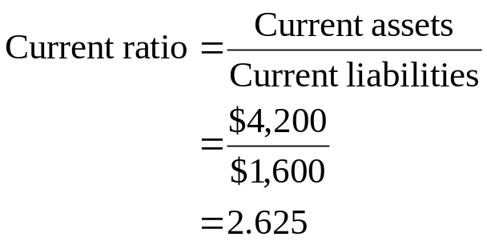
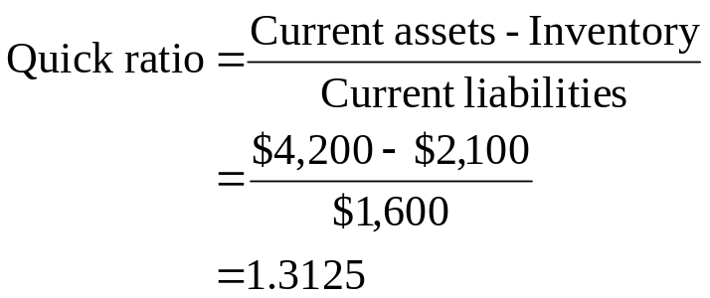
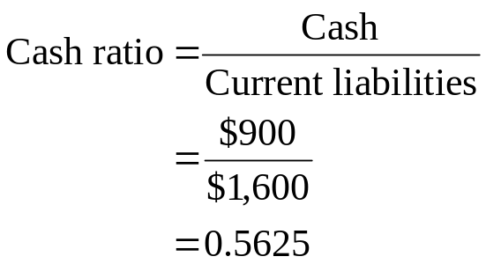
14: Liquidity ratios
Cash $ 900
Accounts receivable 1,200
Inventory 2,100
Current assets $4,200
Accounts payable 1,600
Current liabilities $1,600
Answers continued on next slide.

Slide 16
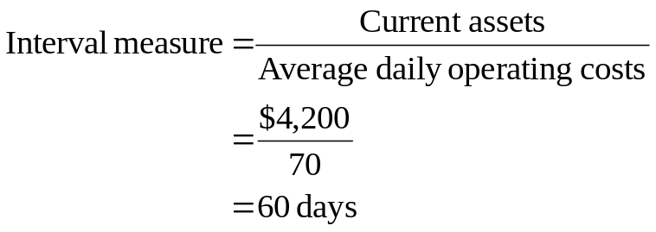
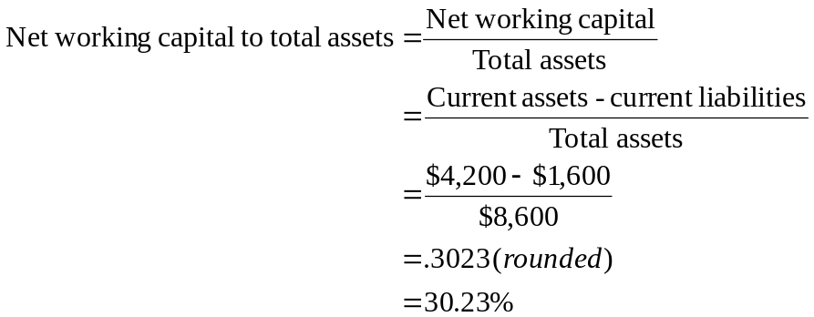
15: Liquidity ratios
Cash $ 900
Accounts receivable $1,200
Inventory $2,100
Accounts payable $1,600
Average daily operating costs $ 70
Total assets $8,600

Slide 17
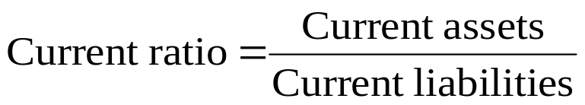
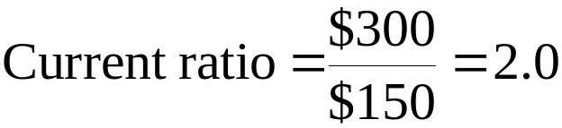
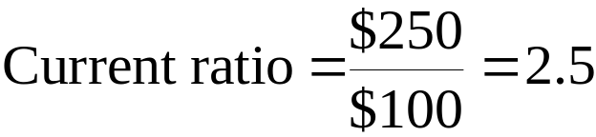
16: Liquidity ratios
Assume you start with this situation:
Cash $100
Accounts receivable 100
Inventory 100
Total current assets $300
Accounts payable $150
Total current liabilities $150
Now assume you pay $50 on your accounts payable. You now have this situation.
Cash $ 50
Accounts receivable 100
Inventory 100
Total current assets $250
Accounts payable $100
Total current liabilities $100

Slide 18
17: Liquidity ratios
Indicate for each action whether the current ratio, the quick ratio and the cash ratio will increase (I), decrease (D) or not change (NC). Assume net working capital is positive.
Current Quick Cash
1. Short-term debt is paid ______ ______ _____
2. Long-term debt is paid ______ ______ _____
3. Inventory is sold on credit at a profit ______ ______ _____
4. Inventory is sold for cash at cost ______ ______ _____
5. A customer pays their bill ______ ______ _____
6. Inventory is purchased on accounts
payable ______ ______ _____
7. Inventory is purchased for cash
8. Cash is received from long-term loan ______ ______ _____

Slide 19
18: Liquidity ratios
Current Quick Cash
1. Short-term debt is paid I I I
2. Long-term debt is paid D D D
3. Inventory is sold on credit at a profit I I NC
4. Inventory is sold for cash at cost NC I I
5. A customer pays their bill NC NC I
6. Inventory is purchased on accounts
payable D D D
7. Inventory is purchased for cash NC D D
8. Cash is received from long-term loan I I I

Slide 20
19: Long-term solvency ratios
Total assets
Long-term debt
Total debt
Total equity
EBIT (Earnings Before Interest and Taxes)
Interest
Depreciation

Slide 21
20: Long-term solvency ratios
Your firm has total assets of $146,000 and a total debt ratio of 40%.
What is the firm’s debt-equity ratio?

Slide 22
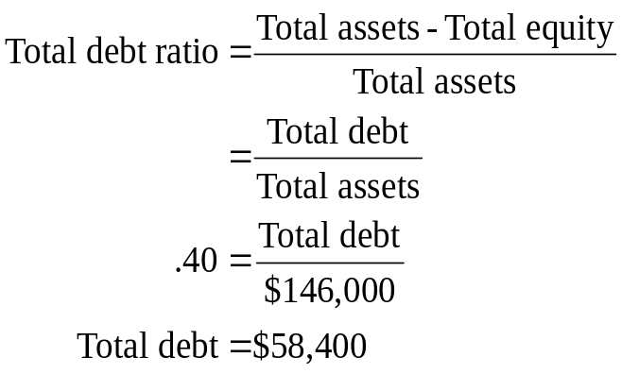
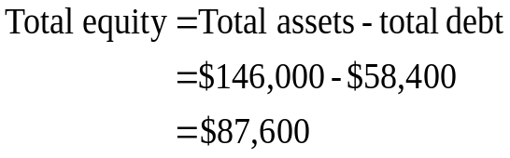
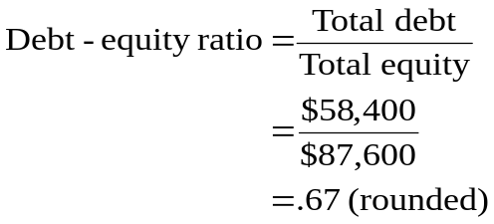
21: Long-term solvency ratios
Your firm has total assets of $146,000 and a total debt ratio of 40%. What is the firm’s debt-equity ratio?
Step 1: Find total debt
Step 2: Find total equity
Step 3: Find debt-equity ratio

Slide 23
22: Long-term solvency ratios
Your firm has long-term debt of $63,000. The long-term debt ratio is .40 and the equity multiplier is 1.8. What is the amount of total assets?
Try this. If you get stuck, proceed to the next slide for a hint.

Slide 24
23: Long-term solvency ratios
Your firm has long-term debt of $63,000. The long-term debt ratio is .40 and the equity multiplier is 1.8. What is the amount of total assets?
Hint: By using the equity multiplier you can determine the amount of total assets. But, you will need to know the amount of total equity. Total equity can be found by using the long-term debt ratio.

Slide 25
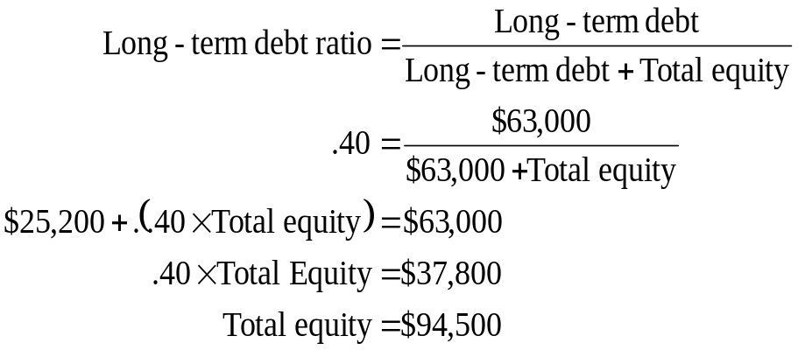
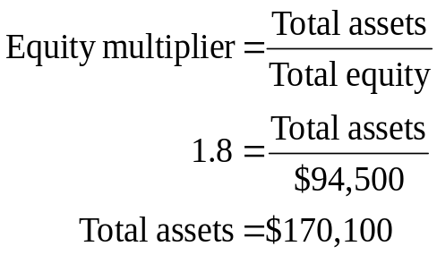
24: Long-term solvency ratios
Your firm has long-term debt of $63,000. The long-term debt ratio is .40 and the equity multiplier is 1.8. What is the amount of total assets?
Step 1: Find total equity Step 2: Find total assets

Slide 26
25: Long-term solvency ratios
Your firm has earnings before interest and taxes of $27,931. The times interest earned ratio is 5.3 and the cash coverage ratio is 8.6.
What is the amount of the interest paid expense?
What is the amount of the depreciation expense?

Slide 27
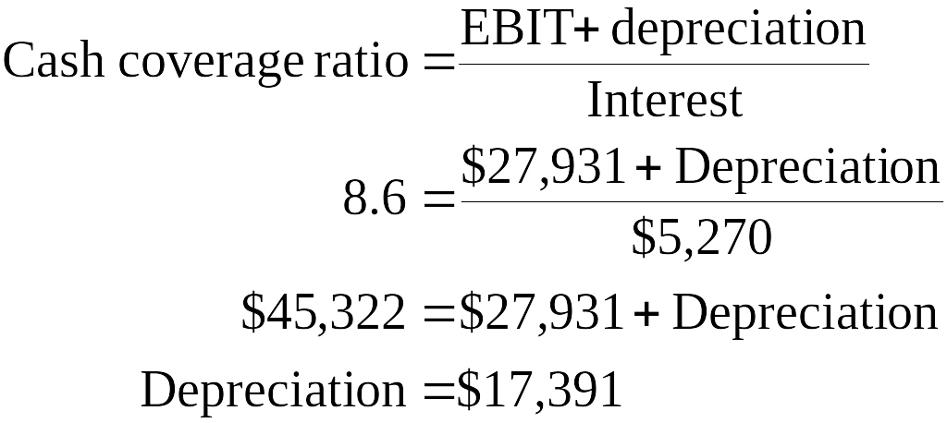
26: Long-term solvency ratios
Your firm has earnings before interest and taxes of $27,931. The times interest earned ratio is 5.3 and the cash coverage ratio is 8.6.
Step 1: Find the interest expense using
the times interest earned ratio
Step 2: Find the depreciation expense
using the cash coverage ratio

Slide 28
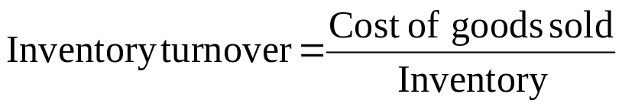
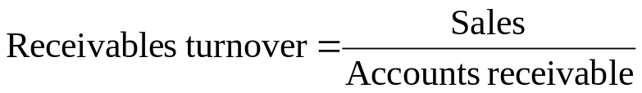
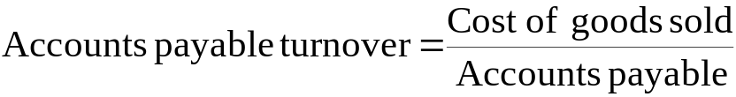
27: Asset utilization ratios
Sales and accounts receivables are valued at the retail selling price. Cost of goods sold, inventory and accounts payable are valued at the wholesale purchase price.
When computing turnover rates, you match retail prices with retail prices. You match wholesale prices with wholesale prices as seen in the formulas.
Retail Prices Wholesale Prices

Slide 29
28: Asset utilization ratios
Your firm has sales of $927,450, accounts receivables of $34,350, inventory of $48,600 and costs of goods sold of $648,810.
What is the inventory turnover rate?
How many days does it take to sell inventory?
What is the accounts receivable turnover rate?
How many days does it take to collect payment from a customer?
Round your answers to two decimal places.

Slide 30
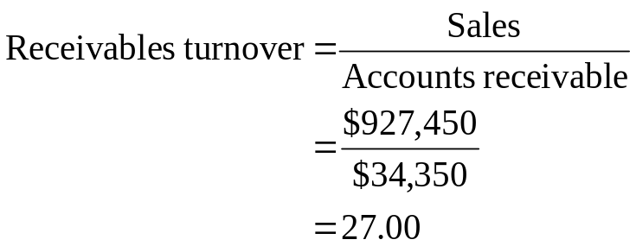
29: Asset utilization ratios
Your firm has sales of $927,450, accounts receivables of $34,350, inventory of $48,600 and costs of goods sold of $648,810.

Slide 31
30: Asset utilization ratios
Your firm has current liabilities of $21,800, total assets of $82,900 and sales of $149,200. The net working capital is $4,600.
What is the NWC turnover rate?
What is the fixed asset turnover rate?
Round the turnover rates to two decimal places.

Slide 32
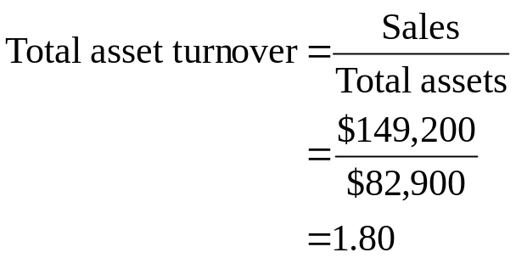
31: Asset utilization ratios
Your firm has current liabilities of $21,800, total assets of $82,900 and sales of $149,200. The net working capital is $4,600.

Slide 33
32: Asset utilization ratios
Your firm has current liabilities of $21,800, total assets of $82,900 and sales of $149,200. The net working capital is $4,600.
What is the total asset turnover rate?
Round the turnover rate to two decimal places.

Slide 34
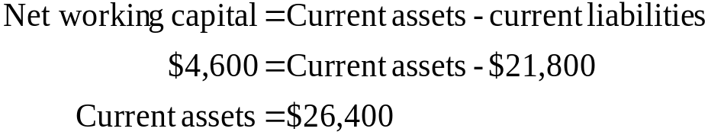
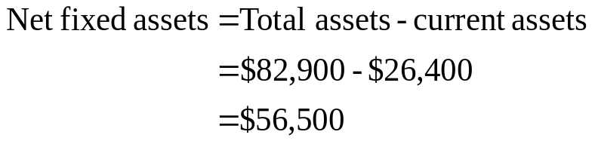
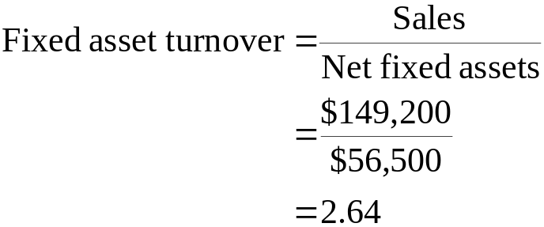
33: Asset utilization ratios
Your firm has current liabilities of $21,800, total assets of $82,900 and sales of $149,200. The net working capital is $4,600.

Slide 35
34: Profitability ratios
Your firm has net income of $123,000 on sales of $2.4 million. Total assets are $2.46 million and total equity is $1.5 million.
What is the profit margin?
What is the return on assets?
What is the return on equity?

Slide 36
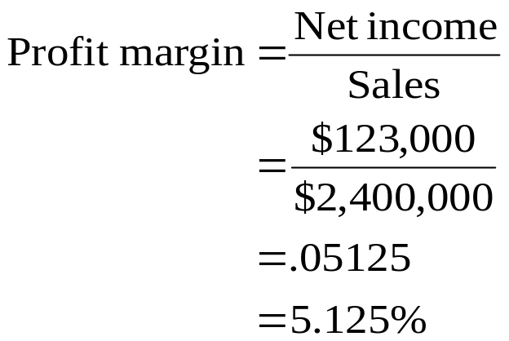
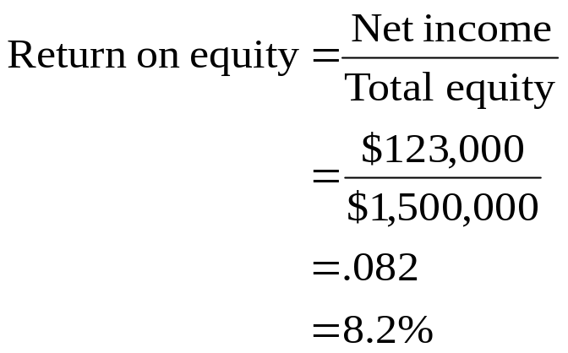
35: Profitability ratios
Your firm has net income of $123,000 on sales of $2.4 million. Total assets are $2.46 million and total equity is $1.5 million.

Slide 37
36: Profitability ratios
Your firm has net income of $368,400, total assets of $23.946 million and an equity multiplier of 1.6.
What is the return on equity?

Slide 38
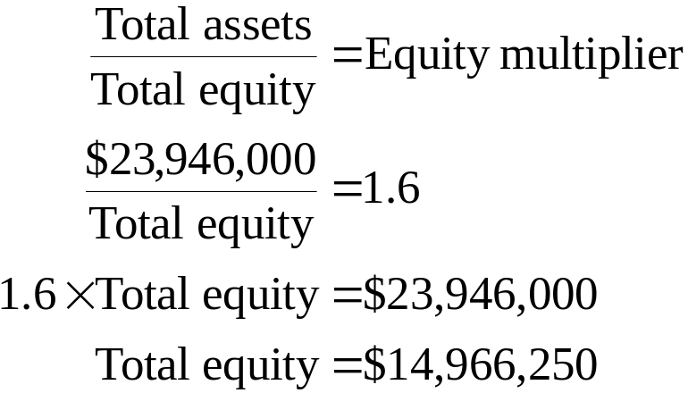
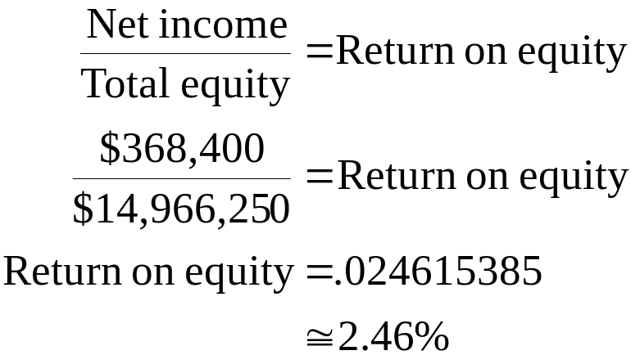
37: Profitability ratios
Your firm has net income of $368,400, total assets of $23.946 million and an equity multiplier of 1.6. What is the return on equity?
Step 1: Find total equity (TE)
Step 2: Find return on equity (ROE)

Slide 39
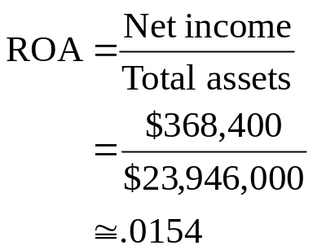
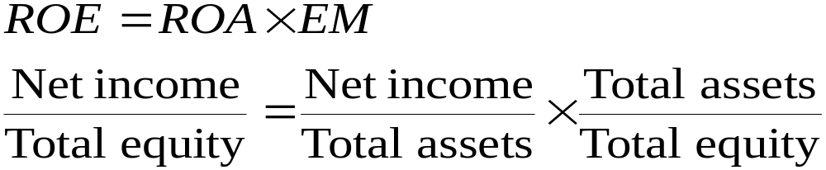
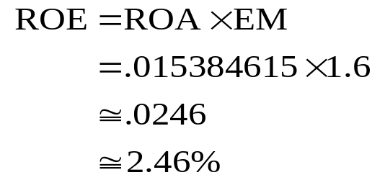
38: Profitability ratios
A firm has net income of $368,400, total assets of $23.946 million and an equity multiplier of 1.6. What is the return on equity?
Step 1. Compute ROA
Step 2. Compute ROE

Slide 40
39: Profitability ratios
What is the DuPont formula?
What is each part of the DuPont formula called?
Why use the DuPont formula?

Slide 41
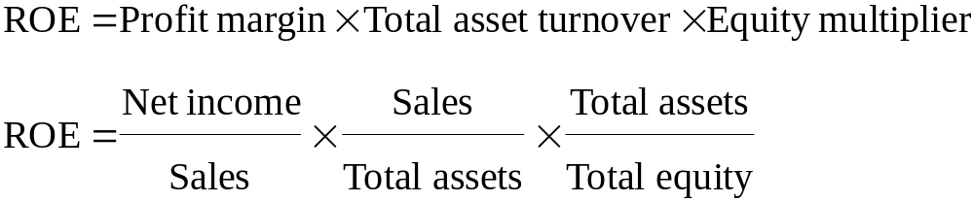
40: Profitability ratios
What is the DuPont formula?
What is each part of the DuPont formula called?
Why use the DuPont formula? (listen for this answer)

Slide 42
41: Profitability ratios
Your firm has sales of $324,000 and total assets of $216,000. The debt-equity ratio is .5 and the profit margin is 5.4%.
What are the values of the three parts of the DuPont formula?
What is the ROE?
Try to solve this problem before proceeding. If you get stuck, the next slide provides some hints.

Slide 43
42: Profitability ratios
Your firm has sales of $324,000 and total assets of $216,000. The debt-equity ratio is .5 and the profit margin is 5.4%.
What are the values of the three parts of the DuPont formula?
What is the ROE?
Hint:
Step 1: Solve for total equity using the debt-equity ratio and this formula: TA = TD + TE

Slide 44
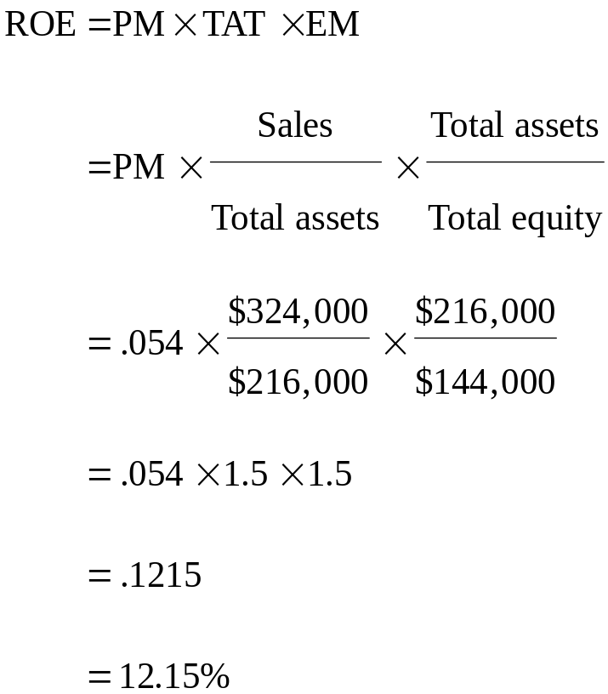
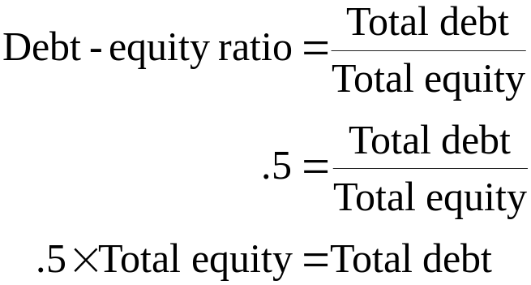
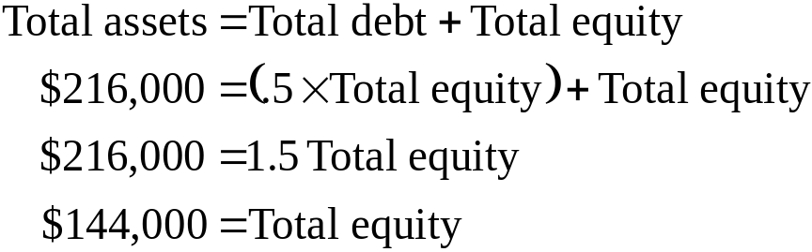
43: Profitability ratios
Your firm has sales of $324,000 and total assets of $216,000. The debt-equity ratio is .5 and the profit margin is 5.4%. What are the values of the three parts of the DuPont formula? What is the ROE?

Slide 45
44: Profitability ratios
Your firm has sales of $12,600, total assets of $8,100, and a debt-equity ratio of .80. The return on equity is 14%.
What is the net income?
Try to solve this by yourself. If you can’t, then see the hint on the next slide.

Slide 46
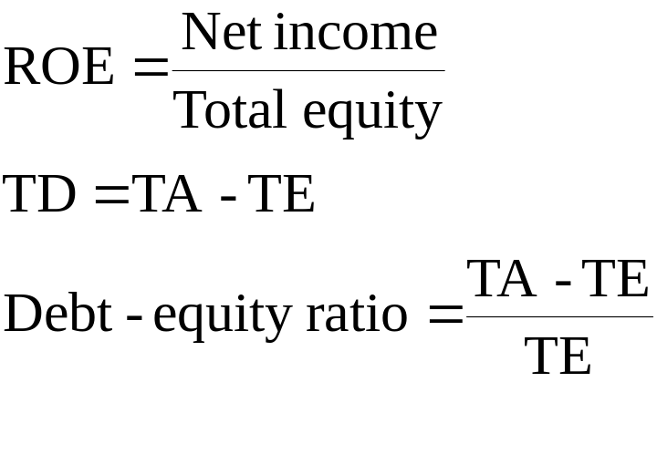
45: Profitability ratios
Your firm has sales of $12,600, total assets of $8,100, and a debt-equity ratio of .80. The return on equity is 14%.
What is the net income?
Here are some formula hints.

Slide 47
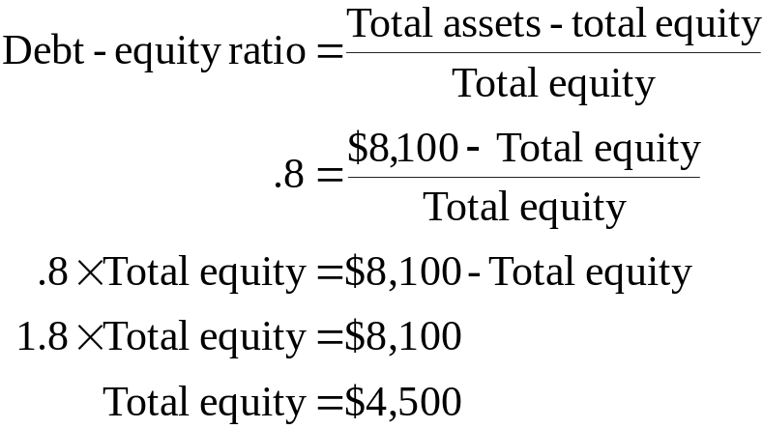
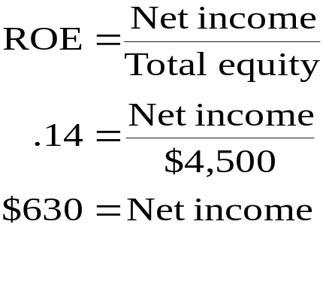
46: Profitability ratios
Your firm has sales of $12,600, total assets of $8,100, and a debt-equity ratio of .80. The return on equity is 14%.
What is the net income?

Slide 48
47: Market value ratios
A firm has net income of $638,000 and total equity of $3.828 million. There are 200,000 shares of common stock outstanding. Each share is currently selling for $76.56.
What is the P/E ratio?
What is the market-to-book ratio?

Slide 49
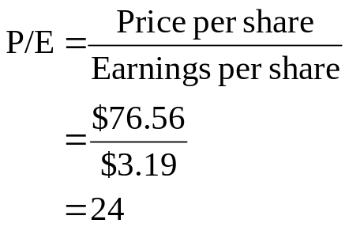
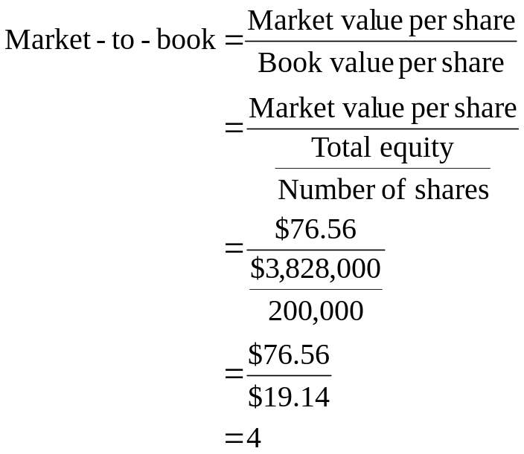
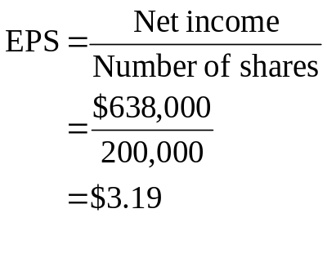
48: Market value ratios
A firm has net income of $638,000 and total equity of $3.828 million. There are 200,000 shares of common stock outstanding. Each share is currently selling for $76.56.

Slide 50
3
End of Chapter 3

